Slide 1
Transforming a global B2B software / information services provider into a customer-centric digital led marketer
TMT| N. AMERICA
MED011
Client context
Approach
Impact
Global B2B Software / Information Services provider with traditional marketing approach:
“Product centric” marketing approach with overlapping tactics
Generalist workforce without deep expertise
Fragmented CX across different journeys
Siloed / decentralized functions across globe with shadow organizations
Waterfall approach for campaign launches
No common currency of marketing activity measurement
Sub-scale digital capabilities and adoption with few pockets of excellence
Overall organization moving ahead with agile and delayering transformation while marketing was left behind
Created marketing target state to become the growth engine for the company as a customer centric, digital/omni and data driven function
Benchmarked client’s target organization size against best in class B2B tech providers, client interviews, and expert interviews
Consolidated siloed organizations across the globe and created a balanced marketing structure with 50% of the resources in the segments and 50% of the resources at the center driving excellence around digital and brand
Ran working sessions to identify the critical interlocks and use cases to align the operating model for the target state
Identified key capability gaps and created a multi-phase implementation roadmap
Trained key leadership on agile marketing to get them ready for test & learn in a leaner organization
Stood up a new marketing organization (~500 FTEs) with clear roles and responsibilities
Created two new centralized functions:
Enterprise Digital to drive the design and execution of E2E digital journeys with deep expertise in digital marketing and e-commerce
Enterprise Brand to shape and own the brand globally
Delivered a more efficient organization with annual FTE savings of $25MM (80% of the savings identified and implemented during the study)
Started the implementation of digital, data and tech enabled operating model and culture in the segments and the center
Agreed on a path forward with clear guidelines on prioritization
Client name: X
Team set-up: X
Fees Structure: X
What was unique: X

Slide 2
To start the transformation, it is critical for leaders and marketing employees to align on a vision ….
From…
…To
Customer centric focus
Product-first marketing strategy reflective of what we can sell not what the customer wants
Fragmented and disjointed customer experience across product teams
Customer focused strategy focused on pain points and understanding what truly matters for our customers
We build answers and content for customers through end to end journey
Enterprise and segment design
Siloed and decentralized marketing teams within segments disconnected from each other
Many messages across teams leading to collisions that confuse our customers
Integrated marketing teams sharing learnings and best practices with a common currency to measure results
Consistent campaigns and messaging strategy delivered around common growth levers
Agile & Capability-driven
Waterfall approach to campaign marketing inhibits test and learn results
Marketing generalist orientation vs. specialization in next gen marketing skills
Pooled, cross functional resources that can be flexibly deployed against highest priority areas
Capability-driven teams building and sharing deep functional knowledge
Digital-first
Sub-scalability digital capabilities (e.g., Digital Marketing, Analytics and CRM) required to win
Many incomplete views of customer resulting in disjointed communications and collisions (e.g., multiple Eloqua instances)
Always on omnichannel campaigns around end-to-end customer journey, powered by unified martech strategy
Unified customer data platform tracking all customer interactions (including 1st party and 3rd party data) to enable growth levers

Slide 3
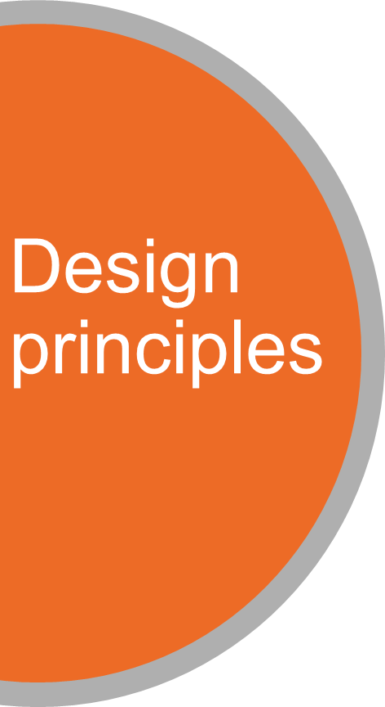
…combined with design principles to win in the rapidly changing digital world
Description
Customer centricity
Customer needs inspiring all go to market activities (i.e., customer needs drive our strategy, not the products we can sell)
Omnichannel
Leverage scale across all touchpoints and channels to create a unified and frictionless experience
Digital First
Place digital at the core of all customer engagement (vs. part of the marketing mix)
Speed
Speed up decision making by de-layering the process and number of participants required for approvals
Simplicity
Create a more efficient and evenly allocated team structure across enter-prise and segments, with shared vision, ways of working and processes
Data Driven
Empirically-led approach to decision making, powered by advanced analytics & big data (i.e., machine learning)
Test & Learn
Rapid test-and-learn, with an emphasis on speed to market (vs. long-term campaigns)
Cross Functional
Agile, cross-functional teams (i.e., segment, enterprise) to more effectively share information and implement consistent methods and tools across teams
Talent
Attract, develop and retain winning talent with a reputation for being world-class marketers
McKinsey & Company
3
Notes:
NEIL

Slide 4
Then, we focused on three key workstreams with clear deliverables
Details to follow
Key actions we took
What we accomplished
Organization design
Used benchmarks for a top-down and interviews (e.g., client, expert) for a bottoms-up view of the target org size and required capabilities
Started design from top down with detailed roles and responsibilities for the leaders to drive the transformation with right people at the right seats
Transitioned 12 separate marketing teams into 5 functions with distinct roles and aligned capabilities
Shifted from 15% to ~50% marketing FTEs in enterprise capacity to unlock greater scale, deeper capabilities, knowledge sharing and best practices
Operating model
Held deep dive workshops to design critical activities between groups in the marketing organization and between marketing and the rest of the company
Assessed marketing capability across Segment and Enterprise marketing teams across the globe
Refined the operating model and identified critical use cases to set the direction for the workforce
Highlighted risk mitigation strategies and initiated work on key initiatives to mitigate risk in 2019
Assessed capability relative to best in class B2B companies and created a short to long term roadmap
Productivity
Created and executed Productivity initiatives including design principles, spans, layers, FTE sizing, budget envelopes, and future state roles
Sized and benchmarked non-people marketing spend
Identified $25M in savings and achieved 80% of for the existing calendar year
Aligned on productivity charters to monitor progress for 2019

Slide 5
To realize the target organization structure, a segment/region organization will be supported by centralized shared resources
CMO
Segment Marketing and Regional Marketing Leads
Enterprise Digital Lead
Marketing Operations Lead
Brand Marketing Lead
Shape marketing strategy for the Segments
Drive digital strategy and define end-to-end journeys across customer touchpoints
Run marketing forecasting, performance, visualization, compliance and governance for CMO
Own brand and positioning, enterprise content, sponsorships, conferences, and agency management
Highlights
Segment/Region teams act as the translation between business and enterprise resources
Enterprise Digital provides the best in class capabilities and deploys resources in an agile way
Segment / region organizations can combine capabilities given their solution sophistication and revenue
Marketing Strategy & Planning
Digital Strategy & Planning
Compliance & Governance
Enterprise Brand
Strategy
Campaign Planning
Digital User Experience
Insights & Visualization
Agency Management
Market Insights
Digital Marketing (execution & performance)
Performance
Conferences, Sponsorships, & Events
Solution Marketing
Digital Experience Platform
Forecasting
Enterprise Content
Content Marketing
Digital Journey Ownership
Demand Generation
Digital Operations
BDR/SDR
Edge resources
Enterprise resources

Slide 6
After assessing the risk for the transformation, we developed mitigation strategies to help mitigate the risks
Risk assessment and mitigation strategies
Methodology
Size of bubble represents ease of execution (Smaller size = less complex/easier)
To assess risk, we developed different risk scenarios using two primary factors:
Magnitude: impact of people (e.g., reduction in workforce) and non-people factors (e.g., increased agency costs)
Duration and timing: recovery rate to achieve central marketing operational efficiencies (e.g., based on degree of business disruption)
Then, identified four key mitigation strategies to minimize short-term business disruption:
Ruthlessly prioritize marketing activities (e.g., events, emails, webinars) and workflows (e.g., in-house creative studio)
Overinvest in wiring the new operating model (e.g., identify lighthouse initiatives to refine ways of working)
Establish key operational enablers (e.g., launch agile ways of working)
Launch the marketing story, culture and retention efforts (e.g., 1-on-1 meetings)
Return on investment
(Expected MAS / Cost)
C
Low
High
High
Discuss
Prioritize
Fit with strategic priorities
(qualitative)
Deprioritize
Secondary priority (1st backlog)
Low
A
Baseline service level
B
Surge capacity

Slide 7
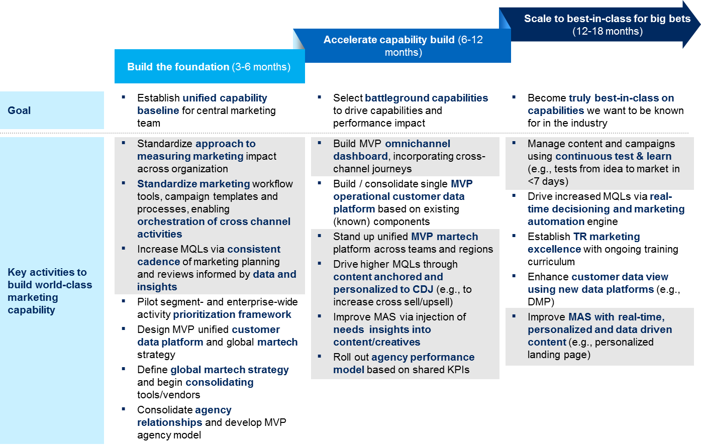
We developed a comprehensive marketing capability roadmap to focus on critical capabilities to be great at
Assessed baseline and identified focus areas
Created an actionable roadmap with three stages to elevate marketing capabilities
focus
Current
state
Proposed target state
2
3
1
Marketing capability dimensions
Lagging
Best Practice
1
2
3
4
5
Marketing processes
Performance marketing
KPIs/measurement/ analytics
Content and creatives
Data activation
Build the foundation to establish unified capability baseline for central marketing
Accelerate capability build by selecting battleground capabilities to drive performance impact
Scale to best-in-class for big bets to be truly known as an industry leader
1
Ad tech & marketing tech
2
Agency management practices
Organization enablers
3

Slide 8



Got any questions? Ask us!
Kelly Ungerman
Robert Tas
Seckin Ozdamar
Partner
Dallas
Partner
New York
Engagement Manager
New York

